Slide 1
Case study (Technical)
August 2018
Customer churn prediction and analysis

Slide 2
Outline
Objectives
Data source
Methodology
Results
Summary

Slide 3
Objectives
Determine factors that contribute towards churn
Predict churn probability
Identify initiatives that could reduce churn

Slide 4
Data source
Customer records
7043 rows
21 features
Primary feature – Churn (yes/no)

Slide 5
Methodology
Prepare data
Remove rows with invalid features
Build candidate models
Logistic regression
Select best performing model
Evaluate each model
Remove redundant features
Bin continuous features
“One-hot” encode categorical features
Extreme gradient boosting
Multilayer perceptron (Artificial neural network)
Random forest
Select model that returns the fewest false positives
Analyse variables
Use variable importance to suggest initiatives that can reduce churn

Slide 6
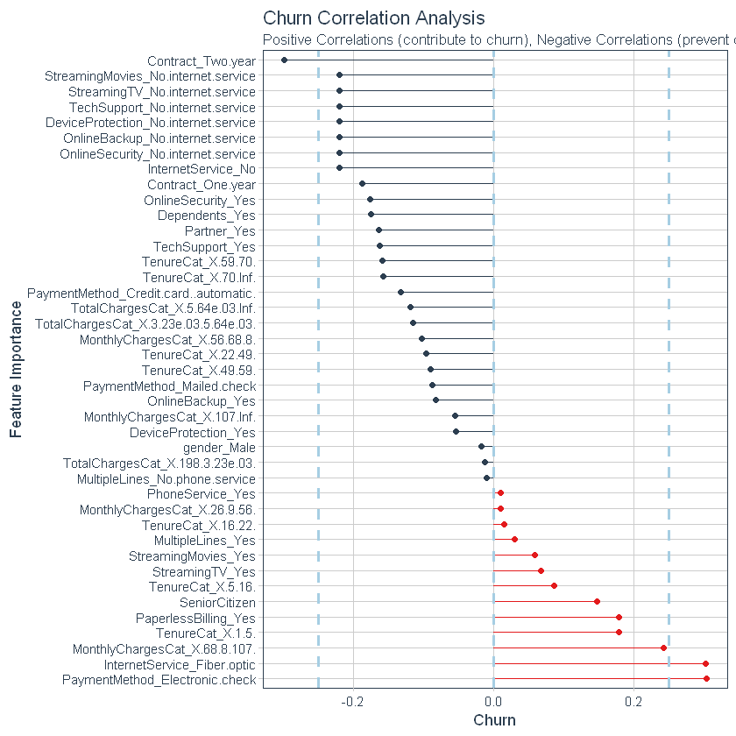
Methodology
Continuous variables were placed in discrete bins using WOE to decrease bias introduced by skewed distributions.
All variables were one hot encoded, scaled and centred to accommodate algorithms that use gradient descent.
80% of the records were randomly selected and used to train models. The remaining 20% were used to test out-of-sample accuracy.
CustomerID was removed, as it provided no predictive value.
All model development was done in Jupyter notebooks using R version 3.5.1

Slide 7
Results
Model performance
 | AUC | Precision | Recall | Parameter tuning
Logistic Regression | 0.8409 | 0.6693 | 0.5186 | No
Extreme Gradient Boosting | 0.8310 | 0.642 | 0.4669 | Yes
Random Forest | 0.8399 | 0.6666 | 0.5125 | Yes
Multilayer Perceptron | 0.8326 | 0.8322 | 0.8995 | No
The MLP model was able to distinguish between true positives and true negatives better than the other models. Performance may be improved by hyperparameter tuning.

Slide 8
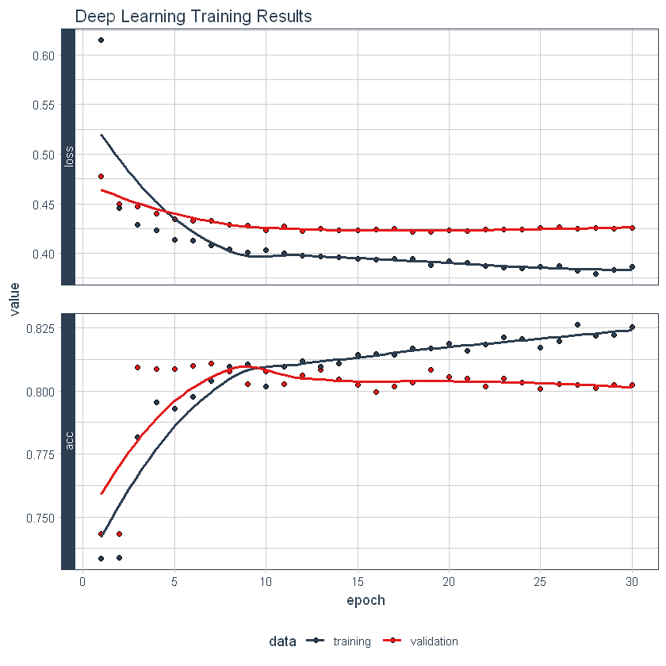
Summary
Model does not seem to be overfit
Parameter tuning may lead to increased model performance
Black box nature of MLP makes it difficult to measure the effect of single variables on the outcome
Model implemented in R with Keras and Tensorflow
Jupyter notebooks with complete model building steps are available.

